Slide 1

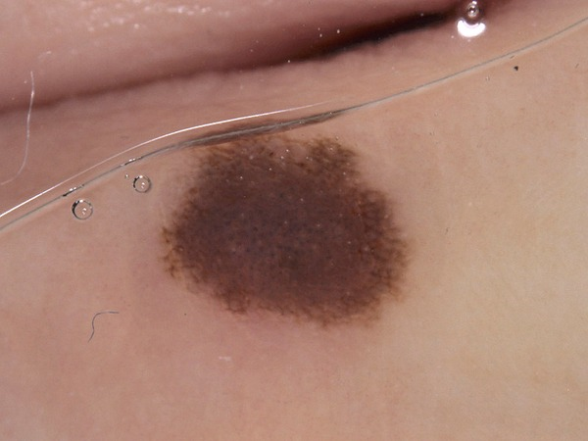
SKIN DISEASE DETECTION USING MACHINE LEARNING

Slide 2
TABLE OF CONTENTS
For What Skin Disease Detection Using Machine Learning Stands
2. Why We Use Machine Learning For Skin Detection
3. Dataset
4. Model
5. Output
6. Problem Faced
7. Future Aspect

Slide 3
For What Skin Disease Detection Using Machine Learning Stands
Skin disease detection using machine learning involves developing algorithms that can accurately identify various skin conditions from images. The project typically consists of several steps:
Data Collection
Data Preprocessing
Model Selection
Model Training
Prediction
Throughout the project, collaboration with dermatologists and medical professionals is essential to ensure the accuracy and reliability of the system in clinical settings.

Slide 4

Why We Use Machine Learning For Skin Disease Detection
The collaboration between machine learning experts and dermatologists in projects involving skin disease detection using machine learning is crucial for several key reasons:
Data Validation and Interpretation
Ethical Considerations and Patient Safety
Clinical Implementation
The collaboration between machine learning experts and dermatologists not only enhances the technical robustness of skin disease detection projects but also ensures that the developments are clinically relevant, ethically sound, and ready for real-world application.

Slide 5

DATASET
Here we are using HAM10000 for dataset
The HAM10000 ("Human Against Machine with 10000 training images") dataset is a widely recognized dataset used in the field of dermatology, particularly for the study and development of automated systems for the diagnosis of skin lesions through machine learning models.
The HAM10000 dataset consists of 10,015 dermatoscopic images which can serve as a training dataset for academic machine learning purposes.

Slide 6
ANNOTATIONS
Lesion ID: Each image is linked to a lesion ID. Some lesions have multiple images, which can provide different views and features of the same lesion.
Diagnostic Labels: Each image in the dataset is annotated with a diagnostic label. The dataset includes a variety of common skin lesion types, which are grouped into seven diagnostic categories:
Melanoma
Melanocytic nevus
Basal cell carcinoma
Actinic keratosis
Benign keratosis
Dermatofi-broma
Vascular lesion

Slide 7
MODEL
Here we are using CNN Model. Convolutional Neural Network (CNN) is a type of deep learning algorithm which is particularly powerful for processing data that has a grid-like topology, such as images. CNNs are widely used in image recognition, image classifications, object detection, and similar tasks, making them integral to the fields of computer vision and medical image analysis.
Core Components of CNNs:-
Input Layer
Convolutional Layers
Activation Function
Pooling (Subsampling or Down-sampling)
Flatten Layer
Output Layer

Slide 8
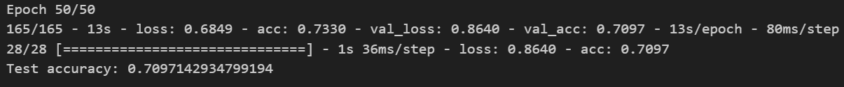

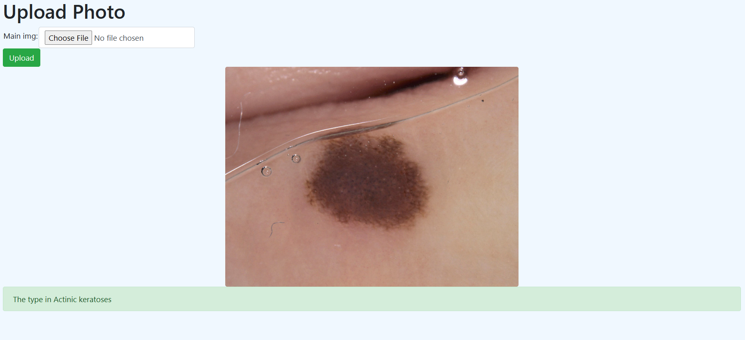
OUTPUT
The accuracy of our trained model is 70.97142934799194%
For Prediction, we have created a website using flask and html:

Slide 9
PROBLEMS FACED WHILE MAKING THIS MODEL
When implementing a Convolutional Neural Network (CNN) for skin disease detection or any similar image classification tasks, several common challenges and problems may arise. Here are some of the main problems faced and potential strategies to overcome them:
1. Data Quality and Quantity
Imbalanced Data: Many medical imaging datasets, including those for skin disease, often have imbalances with some classes being over-represented and others under-represented.
Solution: Use techniques such as resampling the dataset, either by oversampling the minority classes or undersampling the majority classes. Alternatively, adjusting class weights in the training process can help the model pay more attention to under-represented classes.

Slide 10
2. Hardware Limitations
Resource Intensive: Training CNNs, especially deep ones, requires considerable computational power and memory, which can be a limitation if resources are scarce.
Solution: Use more efficient architectures like MobileNet or EfficientNet. Another option is using cloud-based platforms with GPU access for training models.
3. Generalization to New Data
Variability in New Data: Models might perform well on data similar to what they were trained on but poorly on data from different sources, captured under different conditions, or from different demographic groups.
Solution: Include as diverse a dataset as possible during training. Consider domain adaptation techniques if the model needs to be applied to data from different sources.

Slide 11

FUTURE ASPECTS
The future of skin disease detection using machine learning, particularly through convolutional neural networks (CNNs), is promising and likely to see significant advancements and broader integration into clinical practices. Here are several key aspects and developments that could shape the future of this field:
Advancements in AI Technology
Integration with Other Technologies
Internet of Things (IoT)
Increased Automation in Healthcare
Regulatory and Legal Frameworks
Public Acceptance and Education
Augmented Reality (AR) and Virtual Reality (VR)
Certification Standards
Clearer Regulations

Slide 12

Aniket Kumar 221230008
Kshitiz Kanwatia 221230032
Md. Zamin Alam 221230034
Nitin Kushwah 221230042

